Slide 1

CVR COLLEGE OF ENGINEERING
Department of CSE(AI&ML)
Real-Time /Based Research Project -1
Digital Campus Maintenance and Complaint Management System
Team Members(Batch-03)
Juweriya Jasmin-24B81A66M1
N.Priyanka– 24B81A66N6
K.Saraswathi– 24B81A66P5
Under the guidance of
Dr.K.H.VijayaKumari
Assoc.Professor

Slide 2
Outline
Abstract
Introduction
Problem definition
Existing system
Objectives
Hardware software requirements
Methodology/Techniques(System architecture)
Functional and non functional requirements
UML Diagrams
References

Slide 3
Abstract
Manual reporting of complaints causes delays, poor tracking, and lack of accountability.
The Digital Campus Maintenance and Complaint Management System is a web-based platform for efficient issue reporting and tracking.
Students can securely report issues by selecting category, location, and description.
Administrators can view complaints, assign them to maintenance staff, and update issue status.
The system improves transparency, reduces paperwork, speeds up resolution, and enhances campus infrastructure management.

Slide 4
Introduction
Educational institutions consist of large campuses with various facilities such as classrooms, laboratories, hostels, and administrative blocks.
Regular maintenance of these facilities is essential for smooth campus operations.
It is designed to provide an online platform for registering and managing complaints.
The Digital Campus Maintenance and Complaint Management System is developed to manage maintenance-related and complaints in a structured and organized manner

Slide 5
Problem Definition:
Educational institutions require continuous maintenance of infrastructure such as classrooms, laboratories, hostels, and utility services.
In many campuses, maintenance issues are still reported through manual methods like complaint registers, verbal communication, or phone calls.
This creates many problems such as:
Delayed response time due to lack of proper communication channel
Difficulty in tracking complaint status for students and staff
No centralized system to record and manage complaints
Lack of transparency and accountability in issue resolution

Slide 6
Exisisting System:
•The user identifies a maintenance issue on campus • The complaint is reported through a register, verbal communication • Administrative staff manually record the complaint details • Maintenance staff are informed about the issue • The issue is resolved based on staff availability • No online system is used for monitoring or management

Slide 7
Objectives:
To develop a digital platform for complaint management
To provide an easy way for users to register complaints
To improve maintenance response time
To maintain a centralized database of complaints
To enable tracking of complaint status
To reduce paperwork and manual work

Slide 8
Software Requirements
Languages: Python,HTML,CSS
Database:MYSQL
Tools/IDEs:VS Code

Slide 9
Hardware Requirements
RAM:4GB RAM
Disk Space:Minimum 20GB FreeSpace
Operating System:Windows 10/11
Processor:intel core i3 or higher

Slide 10
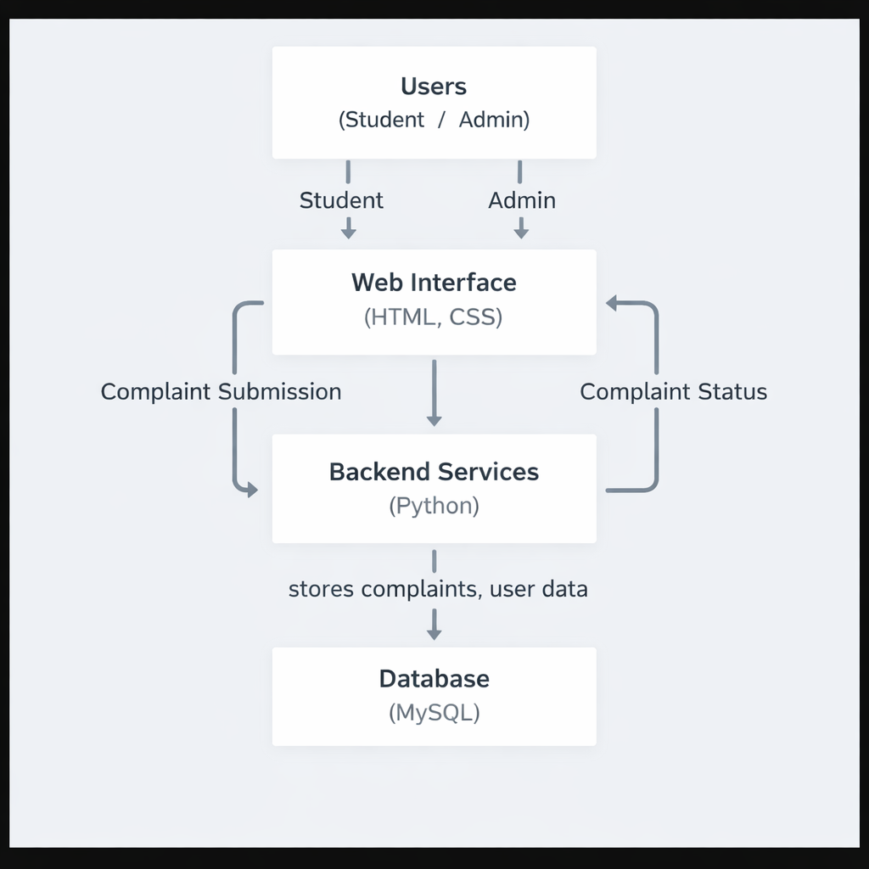
System Architecture:

Slide 11
Functional Requirements:
Users can register and log in securely.
Users can submit complaints with location, and description.
Users can view complaint status.
Admin can view, assign, update, edit, and delete complaints.
The system stores all complaint data in a database.

Slide 12
NON FUNCTIONAL REQUIREMENTS
• Fast performance • Secured system • User-friendly • Reliable
•Scalability • Easy to maintain and update.

Slide 13
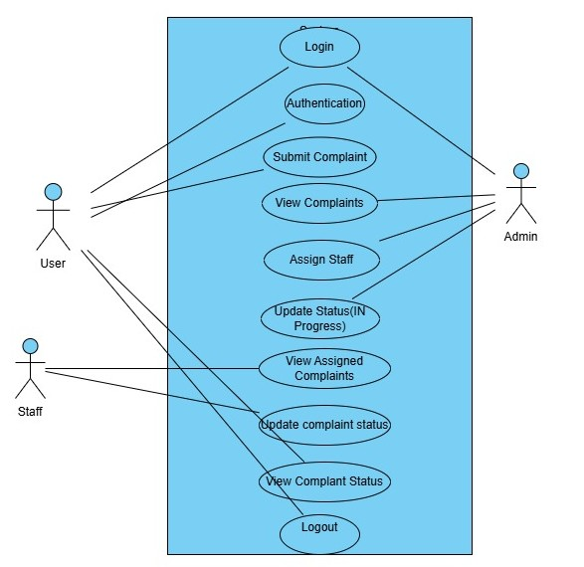
UseCase Diagram:

Slide 14
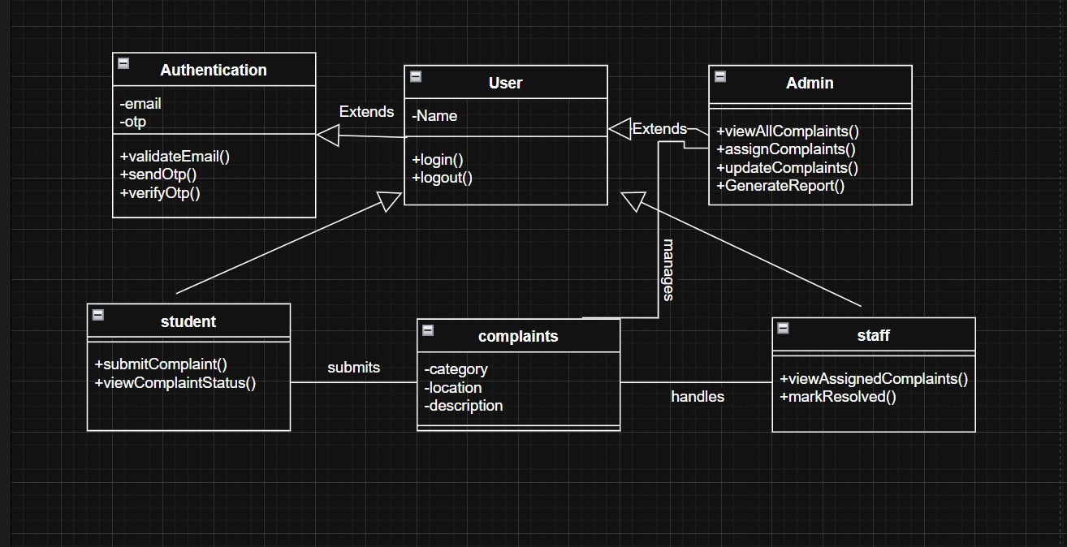
Class Diagram

Slide 15
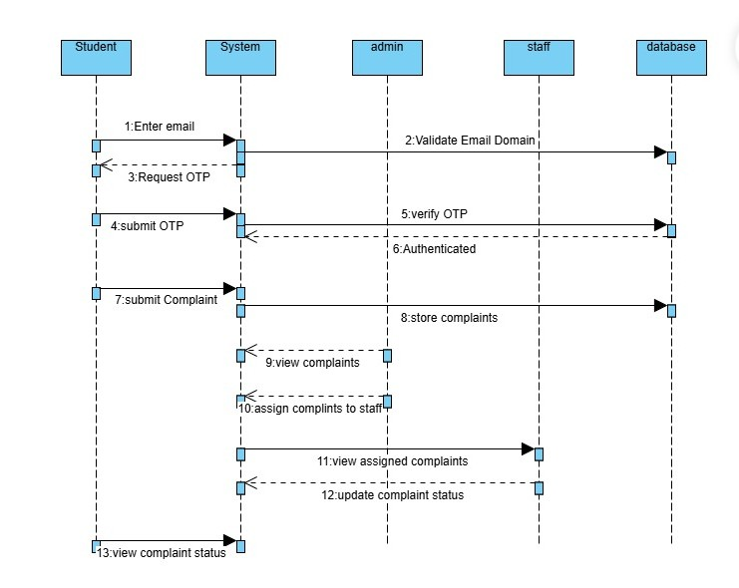
Sequence Diagram:

Slide 16
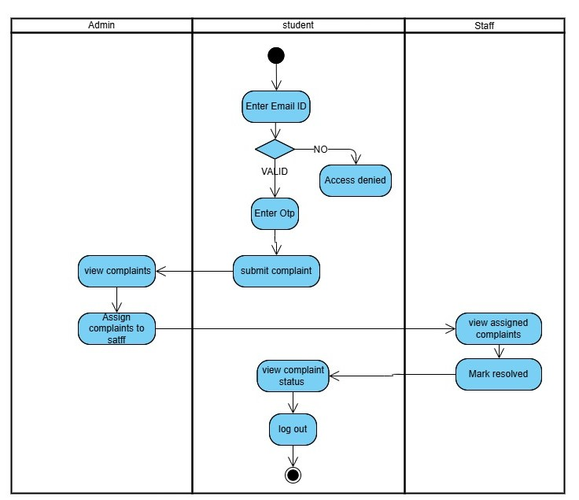
Activity Diagram:

Slide 17
References:
An overview on complaint management system:
https://ijsrst.com/paper/11170.pdf
https://www.researchgate.net/publication/351000536_Development_of_a_Web-Based_Complaint_Management_Platform_for_a_University_Community (by Reasearch Gate-Feb 2021)

Slide 18
Thank you

